Slide 1
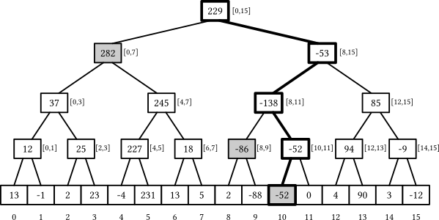
Segment Trees
By Michael Khaykin

Slide 2
What is a Segment Tree?
A segment tree is a structure used to augment existing data into segments, allowing for faster querying of data.
Segment trees are immutable, they are created once based on some initial data and used for querying/updating operations thereafter, no inserting/deleting.

Slide 3
Why Segment Trees?
Segment trees are useful when dealing with operations such as “retrieve some data” or “augment some data” within some range.
Usage: Given an array filled with numbers, return back the maximum number within some range. Arr = { 1, -2, 3, 41, 9, 6, 4, 18 }. GetMax(startIdx: 2, endIdx: 5) = 41. GetMax(startIdx: 4, endIdx: 7) = 18. GetMax(startIdx: 1, endIdx: 2) = 3.

Slide 4
How do we combine nodes?
Segment trees are general purpose, there is no one way to combine nodes, because it would depend on the specific role of the segment tree.
A maximum segment tree might combine nodes as such: parent.Value = Math.Max(left.Value, right.Value)
A summation segment tree might combine nodes a different way, such as: parent.Value = left.Value + right.Value

Slide 5
Construction of a Max Segment Tree:
SegmentTree seg = new SegmentTree({1,-2,3,41,9,6,4,18}) Each value inside the array becomes a leaf node of the segment tree. Each “node” has an interval associated with it, all leaf nodes have a range of [i, i], while parent nodes have larger ranges to include both their children. The root node has interval [0, n - 1]. Time complexity: O(n)

Slide 6
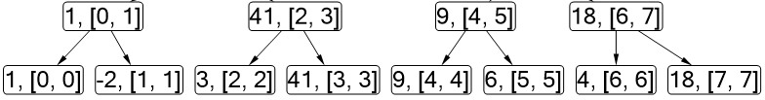
Construction of a Max Segment Tree:
SegmentTree seg = new SegmentTree({1,-2,3,41,9,6,4,18}) Each value inside the array becomes a leaf node of the segment tree. Each “node” has an interval associated with it, all leaf nodes have a range of [i, i], while parent nodes have larger ranges to include both their children. The root node has interval [0, n - 1]. Time complexity: O(n)

Slide 7
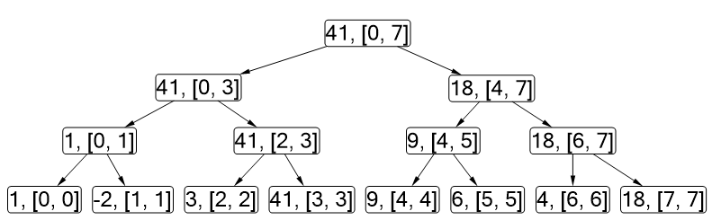
Construction of a Max Segment Tree:
SegmentTree seg = new SegmentTree({1,-2,3,41,9,6,4,18}) Each value inside the array becomes a leaf node of the segment tree. Each “node” has an interval associated with it, all leaf nodes have a range of [i, i], while parent nodes have larger ranges to include both their children. The root node has interval [0, n - 1]. Time complexity: O(n)

Slide 8
Querying in a Segment Tree O(log n):
Situations: interval is fully contained, interval is partially contained, interval is not contained.
Fully_Contained: start <= l && end >= r
return Data[index]
None: r < start || l > end
return defaultValue
Partial: !Fully_Contained && !None
recurse on left and right and return combined result after.

Slide 9
Updating in a Segment Tree O(log n):
Updates leaf nodes, parent nodes and original values in collection that is being augmented.
Similar traversal as the query, but we update at every step in the recursion as long as the interval is AT LEAST partially contained.

Slide 10
Code Demo Time!

Slide 11
Real world applications of Segment Trees:
Computational Geometry
Perimeter of objects in a plane
Static RMQ (Range Minimum Query)
Sum/Product, Min/Max, PrefixSum, etc
Geographic information system
Efficient querying for positioning
Machine Learning/Pattern recognition
Used primarily with image recognition

